Slide 1
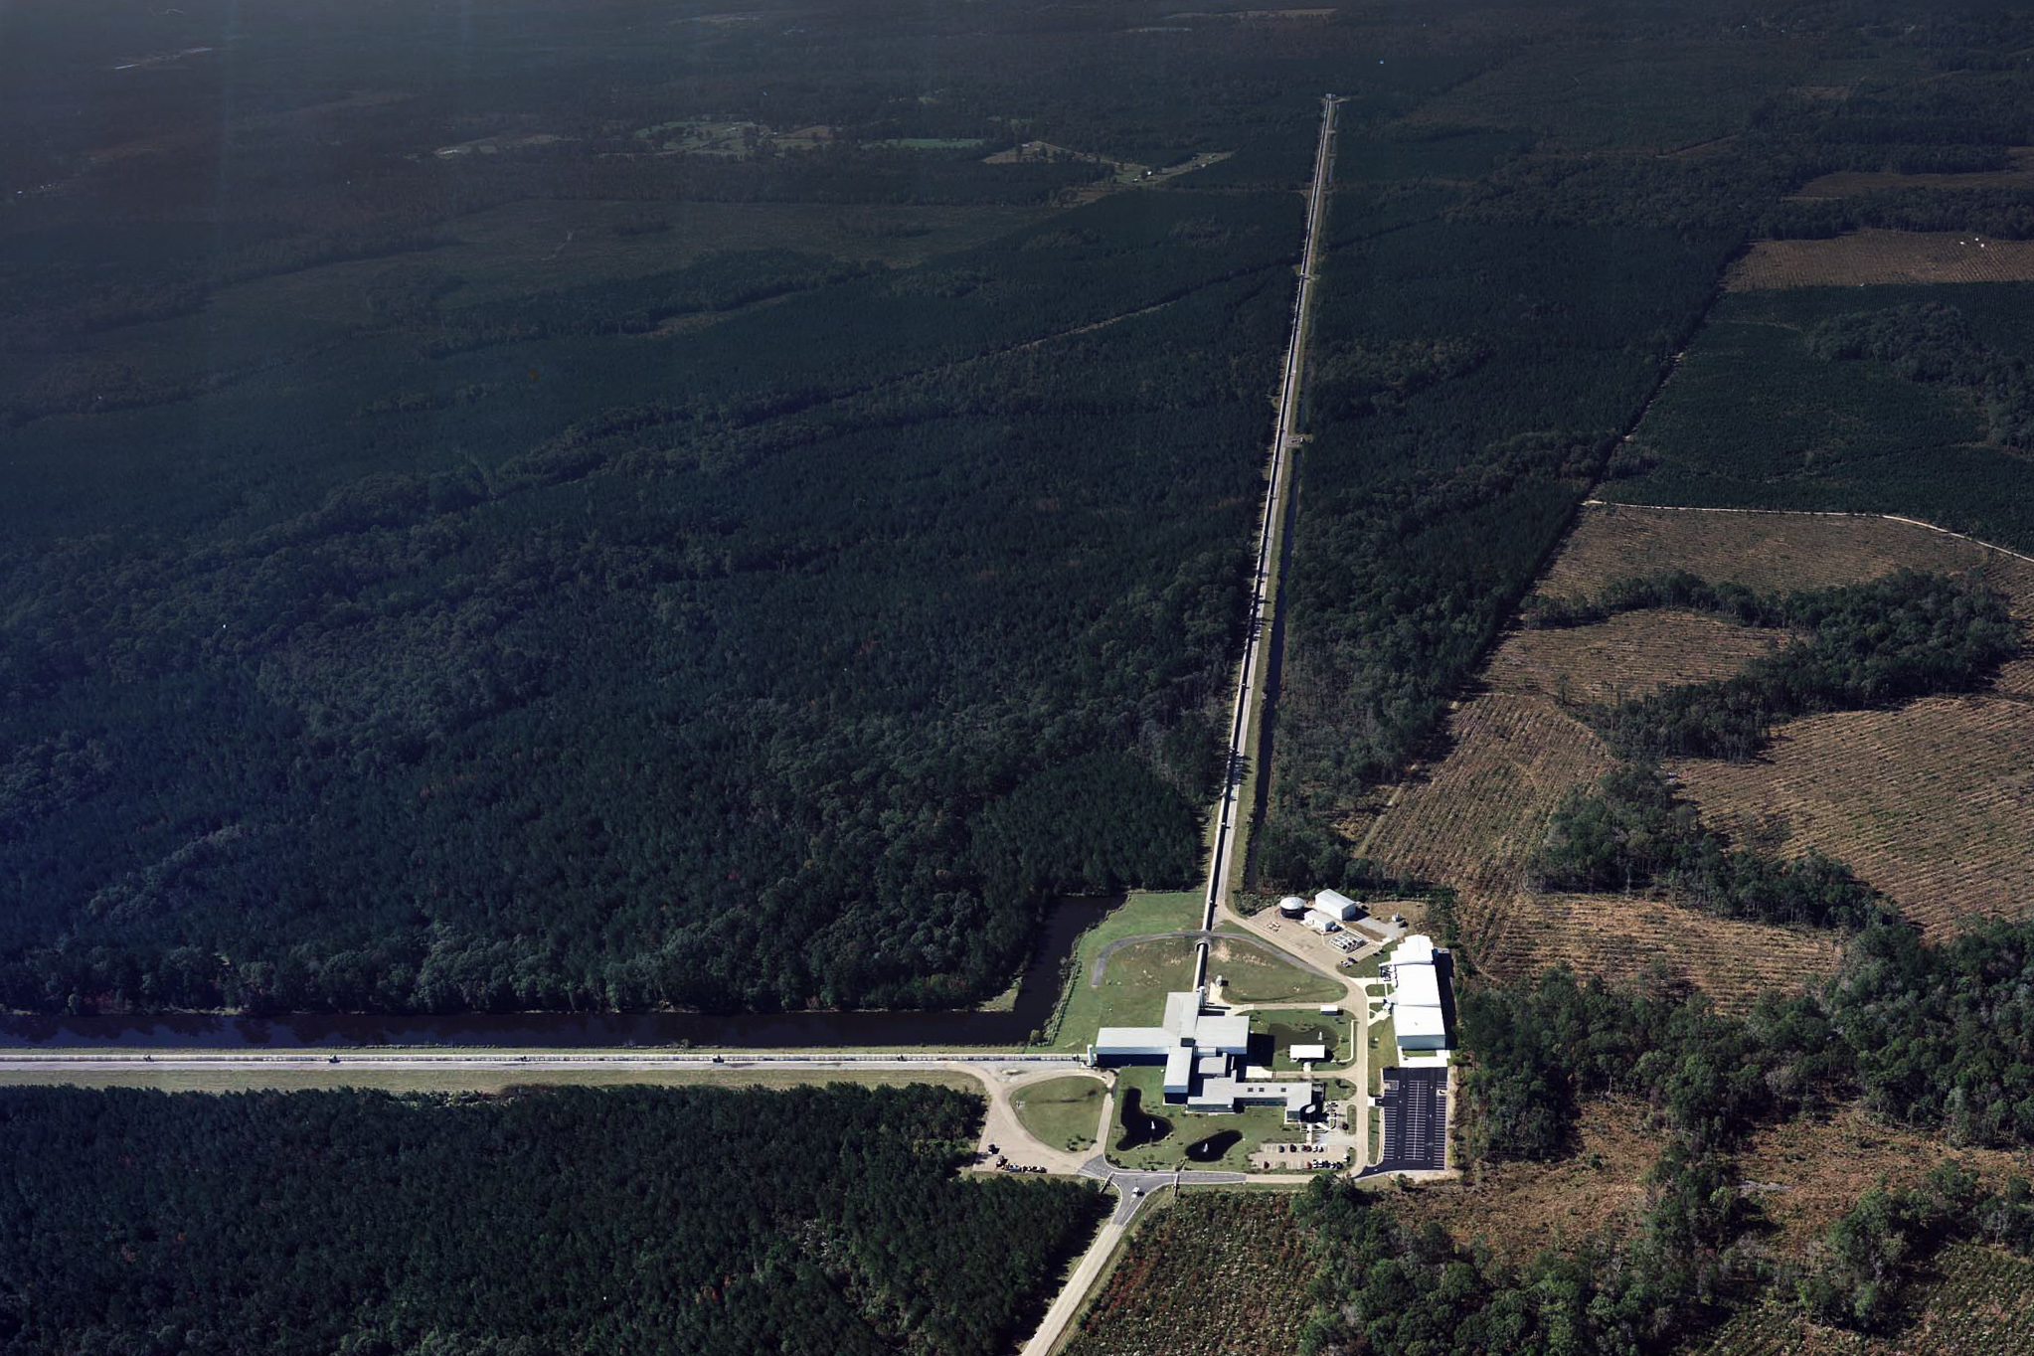
Lights, Inquiry Action!
Sophie Crook,
Kassie Cusachs
Eileen Hite
William Katzman
Every summer, the Exploratorium hosts a Teacher Institute
A National Science Foundation Grant
given to the Baton Rouge Area Foundation
pays for 2 people from Louisiana to go to the Exploratorium for the Teacher Institute

Slide 2
Lights, Inquiry Action!
Agenda:
Peripheral Vision
After Image / Bird in a Cage
Pigment Circles (subtractive colors)
Three Little Pigments
Cheshire Cat

Slide 3
Lights, Inquiry Action!
Peripheral Vision: https://www.exploratorium.edu/snacks/peripheral-vision
Bird in a Cage: https://www.exploratorium.edu/snacks/bird-in-cage
Pigment Circles (subtractive colors)
Three Little Pigments: https://www.exploratorium.edu/snacks/three-little-pigments
Cheshire Cat: https://www.exploratorium.edu/snacks/cheshire-cat

Slide 4
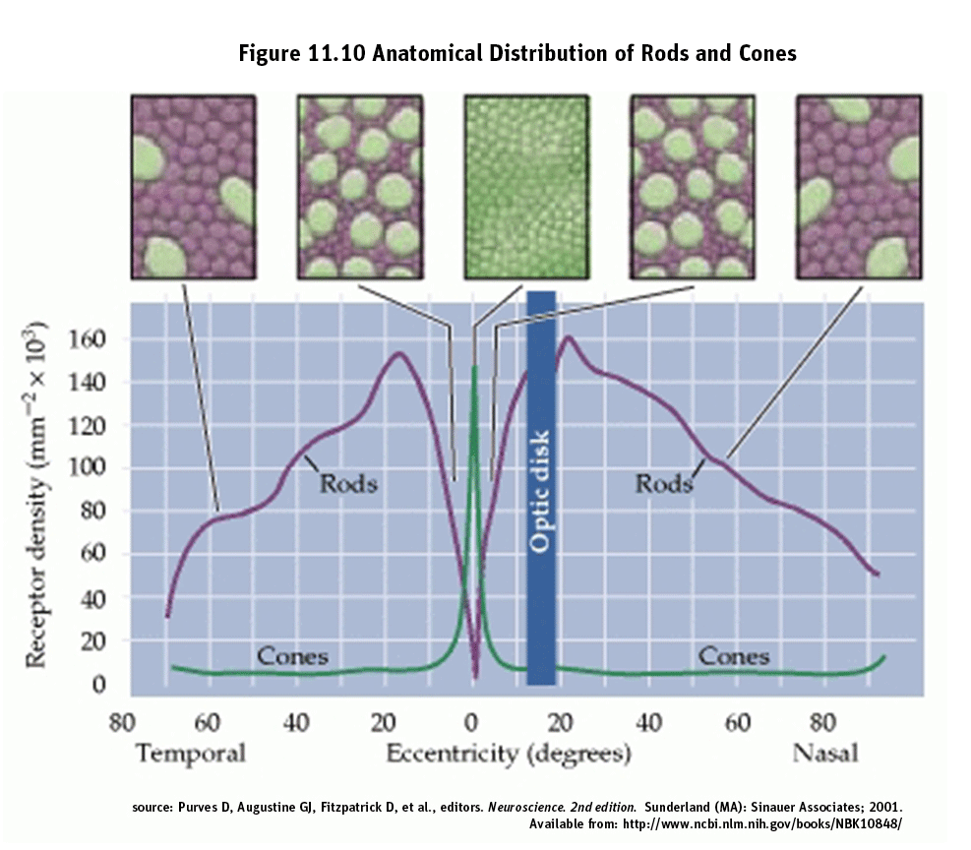
Lights, Inquiry Action!
https://www.exploratorium.edu/snacks/peripheral-vision
https://www.exploratorium.edu/snacks/peripheral-vision

Slide 5
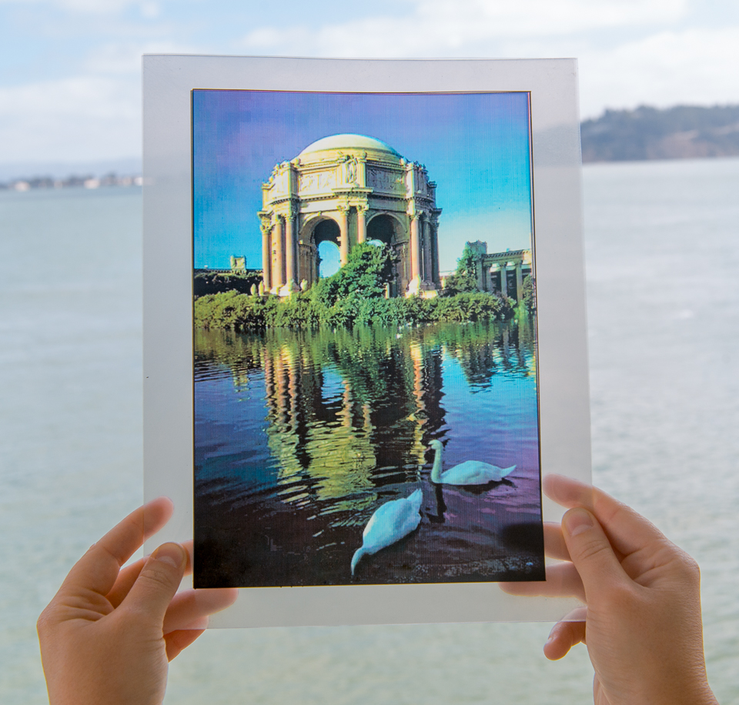
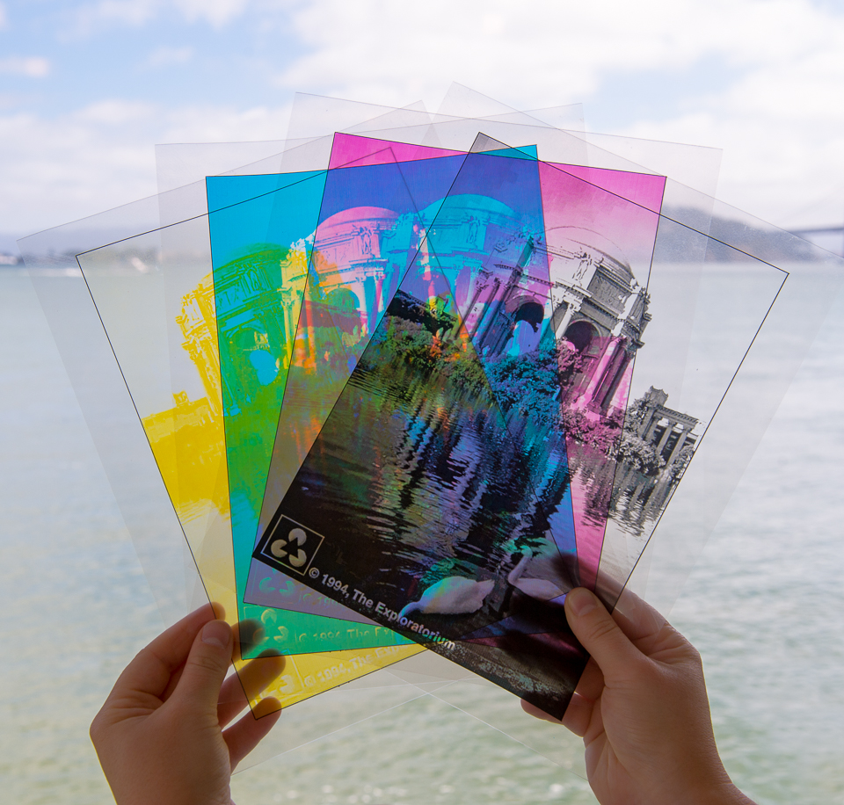
Lights, Inquiry Action! Three Little Pigments

Slide 6
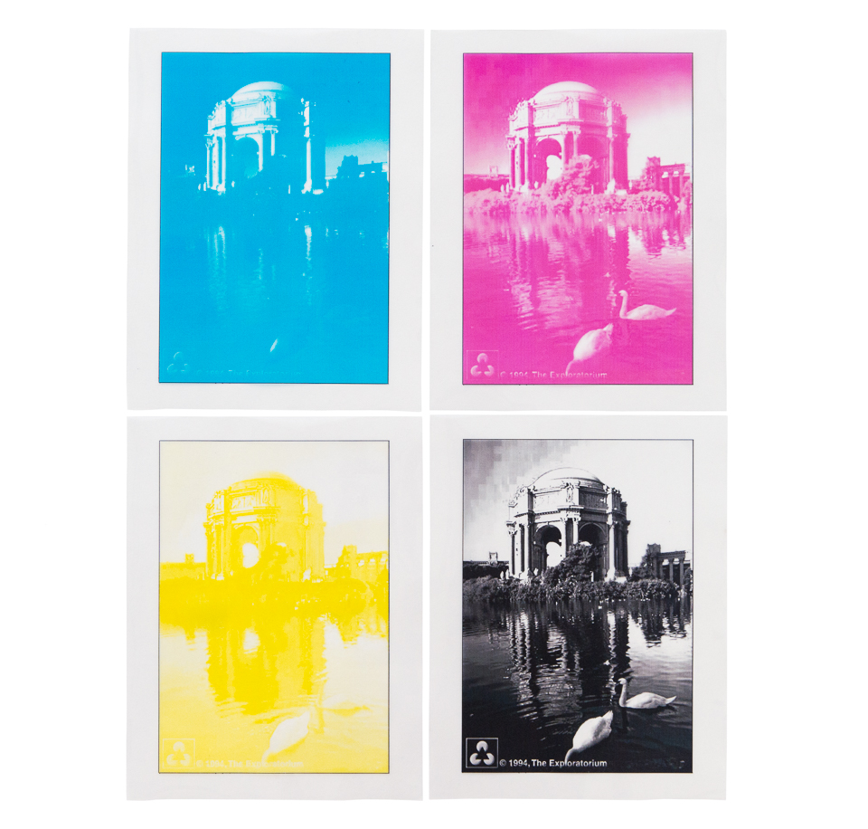
Lights, Inquiry Action!
Materials
Clear acetate transparencies (the ki
Materials

Slide 7
Lights, Inquiry Action!
Materials
A bright light source, such as a lamp.
Clear acetate transparencies (the ki, a projector, or a sunny window.
Assembly
Print a copy of each picture on a separate sheet of transparent acetate. (Note: you'll probably have to insert the acetate sheets into your printer manually.) If your printer cannot print on acetate, your local copy center may be able to help transfer these images onto transparencies.

Slide 8
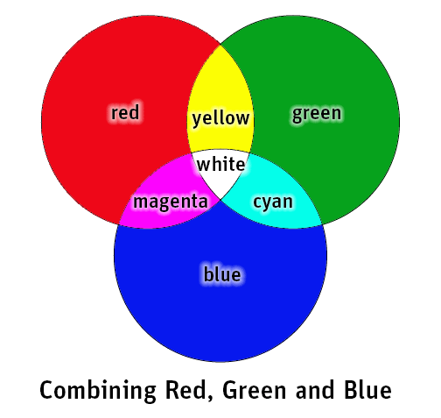
Lights, Inquiry Action!
What’s Going On?
Although white light contains a rainbow of colors, our eyes are only sensitive to red (R), green (G), and blue (B) light. Your brain takes the stimuli from those three colors and interprets all the other colors based on the proportion of R to G to B. Since human brains only process those three colors of light, white light can effectively be described as a combination of RGB.

Slide 9
Lights, Inquiry Action!
Materials
Cyan acetate https://www.exploratorium.edu/sites/default/files/palace-C.jpg
Yellow acetate https://www.exploratorium.edu/sites/default/files/palace-Y.jpg
Magenta acetate https://www.exploratorium.edu/sites/default/files/palace-M.jpg
Black acetate https://www.exploratorium.edu/sites/default/files/palace-K.jpg
Full-color acetate https://www.exploratorium.edu/snacks/peripheral-vision

Slide 10
LIGO SEC Contact Information
www.ligo.caltech.edu/LA
www.ligo.caltech.edu/LA/page/nsta-dec-2017
wkatzman@ligo-la.caltech.edu (my email)

