Slide 1
Warped Spacetime – Gravity Fields
Here we use Lycra/Spandex on embroidery hoops to model spacetime & a metal sphere as a star.
Roll a ball across fabric while on the table.
Lift it up – how is it different? Now roll a ball…
What happens when you just let go of a ball?
What happens if you send a heavy ball around the light ball?
This is a model – what are its strengths and weaknesses?

Slide 2
Warped Spacetime – Gravity Fields 2
Get 2 balls orbiting each other (if you can)
Does the distance change from flat space to curved space? How?
If 2 balls lay next to each other does the distance change the same in each direction?
This is a model – what are its strengths and weaknesses?

Slide 3
Warped Spacetime & Lensing
Lay the fabric hoop on the table with a big metal sphere on it. Now lay down 2 parallel pieces of tape – without wrinkling the tape – is it possible?
Pick up the fabric hoop – what happens to the tape? Re-lay down the tape keeping the tape absolutely flat – what happens?
Notes:
This introduces the concept of gravitational lensing modeled in the next slide.

Slide 4
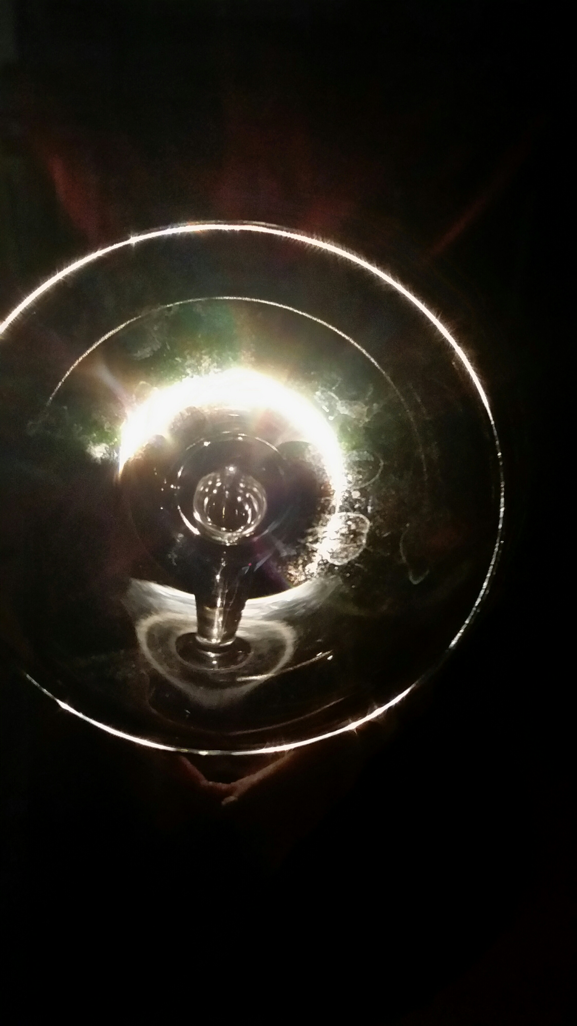
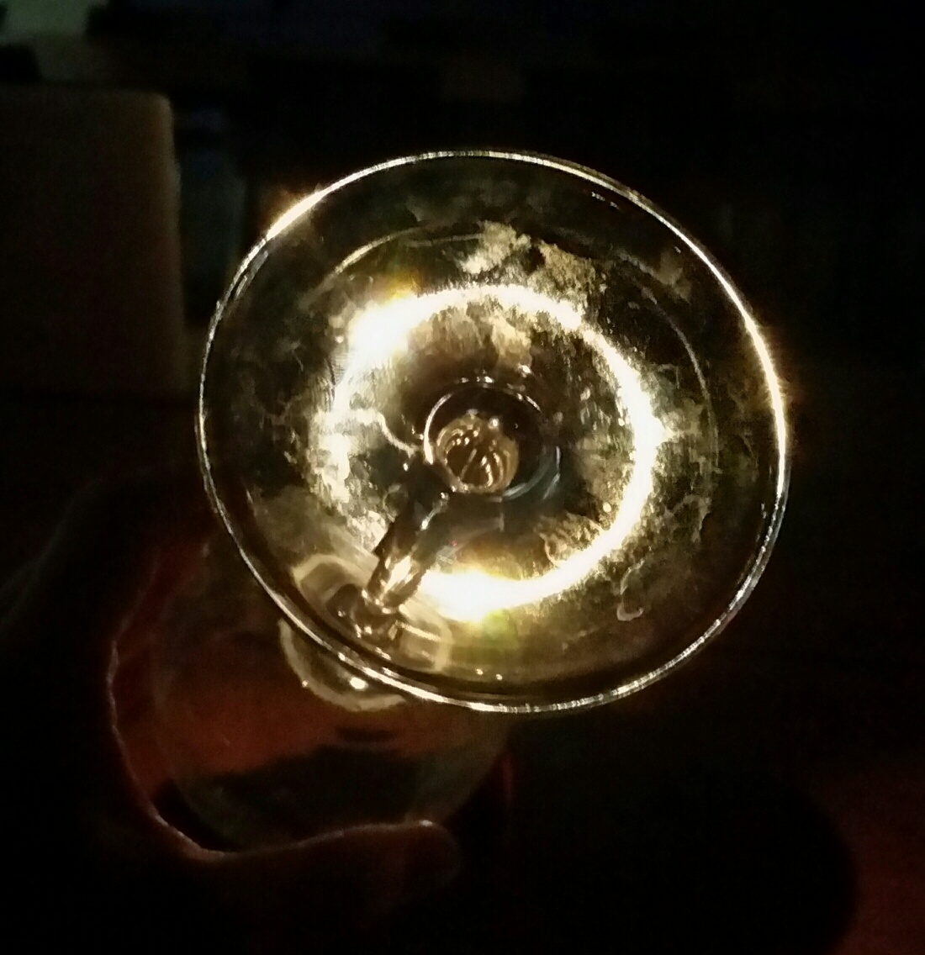
Gravitational Lensing
Look through the base of a wine glass on top of graph paper – notice the distortions.
Aim the wine glass at a Maglite bulb, and see if you can get a ring a the base of the wine glass.
Notes:
This is using the process of refraction to model the bending of light rays around heavy objects. Another activity using a magnet, the small metal ball from the hoop activity, clear cups and a round sticker can also be presented here. The ball lies on the inside bottom of the clear cup (stuck there by the flat rare earth magnet on the outside bottom of the clear cup). Students try not to move relative to the cup and they place a sticker so that they can no longer see the metal ball. As they pour water into the cup, the light rays refract allowing them to see the metal ball. This is similar (but not the same as) the gravitational lensing that was viewable during the 1919 eclipse allowing Arthur Eddington to confirm the predictions made by Einstein’s General Theory or Relativity.

